Slide 1
Data Science with Python Career Program Capstone Project
Name – Luhana Tulshaben
Email – tulsibhojvani99@gmail.com

Slide 2
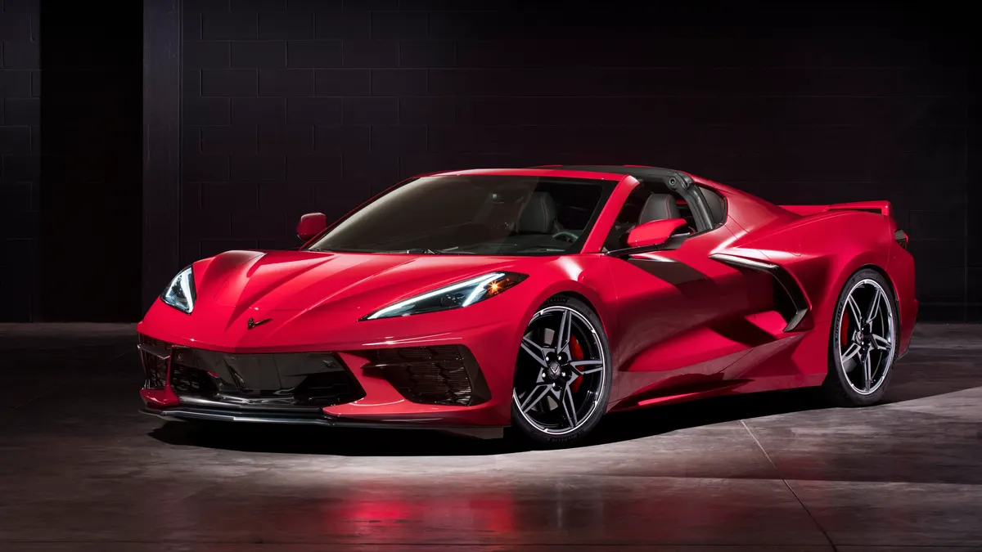
Agenda
Data Exploration
Data insights
EDA Graphs.
Graphical Analysis and conclusion on Data
Data Cleaning & Pre-Processing Steps.
ML Modeling
Deployment of ML Models using Streamlit.

Slide 3
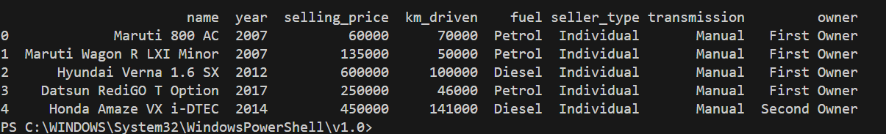
Data Exploration
This data is collected from 'CAR DETAILS'. Following details of cars are included in the dataset: 1) Car name 2) Year 3) Selling Price 4) Kms driven 5) Fuel 6) Seller type 7) Transmission 8) Owner I will try to understand the data, analyze it, extract reports from it, and try to understand the relationships between the different variables

Slide 4
Data insights
Trends in Car Sales: Analyzing the dataset could reveal trends in car sales over time, such as which car models are popular in different years.
Price Correlations: You might discover correlations between certain features (like engine size, mileage, or brand) and the price of the cars.
Geographical Analysis: By examining the data by location, you could identify which types of cars are more popular in specific regions.
Fuel Efficiency Patterns: Insights into fuel efficiency ratings of different car models could be derived, helping consumers make informed decisions about their purchases.
Demographic Preferences: You might find patterns in the types of cars preferred by different age groups or demographics.
Predictive Analysis: Using machine learning techniques, you could build a model to predict car prices based on various features.

Slide 5
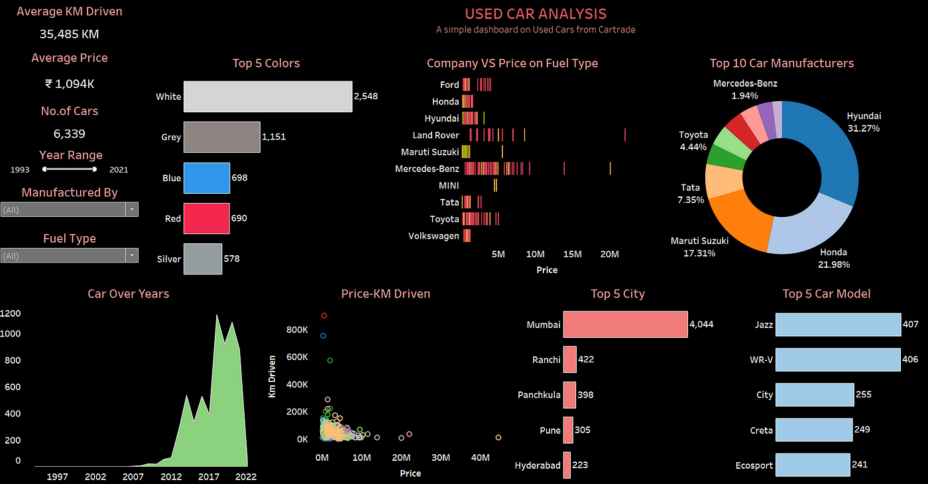
EDA Graphs.

Slide 6
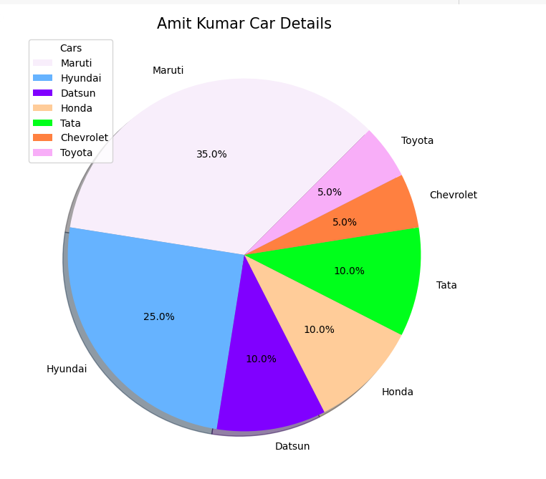
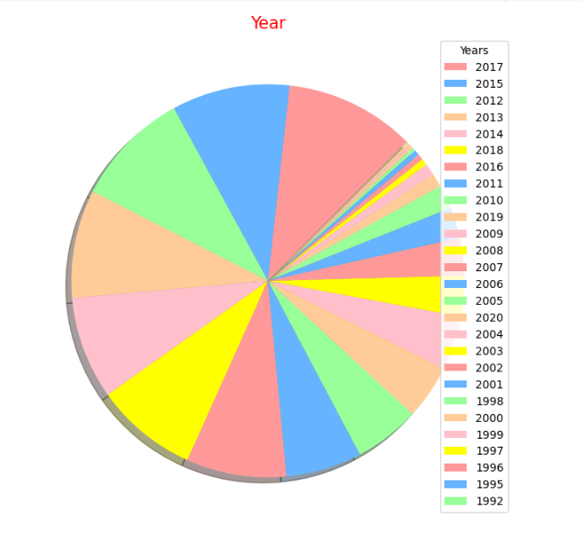
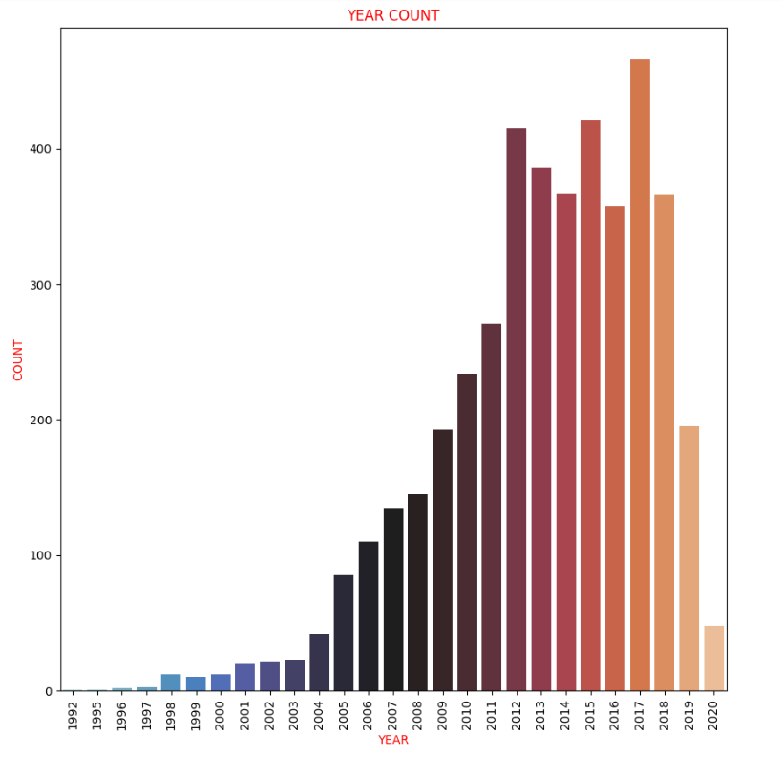
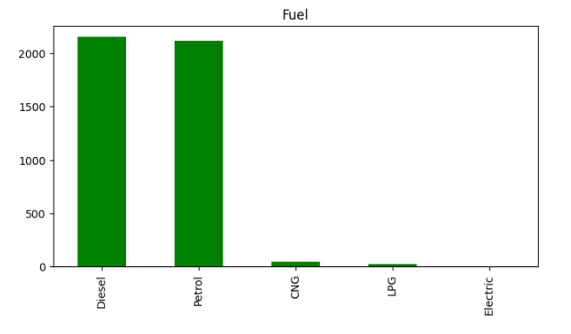
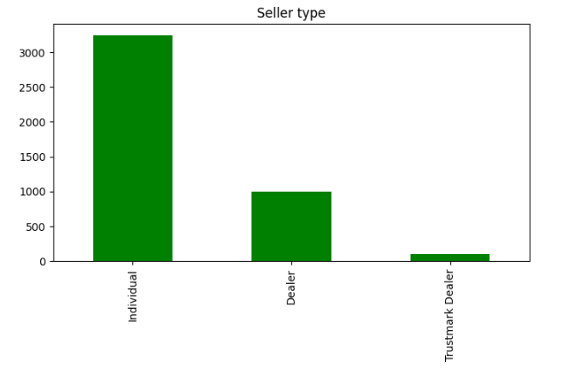
Graphical Analysis and conclusion on Data

Slide 7
Data Cleaning & Pre-Processing Steps.
# Check null values in dataset
df.isnull().sum()
# Check duplicated row in dataset
df[df.duplicated()]
# Drop all duplicated row
df = df.drop_duplicates()
df.shape

Slide 8
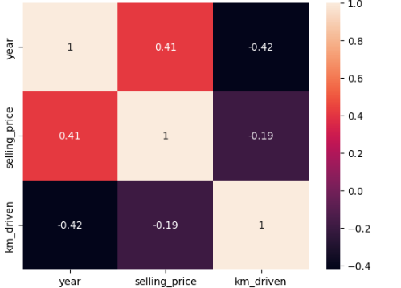
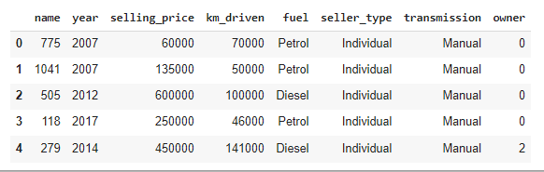
ML Modeling
#We will display heatmap
corr = df.corr()
corr = corr['selling_price']
corr = corr.sort_values(ascending=False)
sns.heatmap(df.corr(), annot=True)
plt.show()
#name--owner--brand convert these columns to numbers
le = preprocessing.LabelEncoder()
df['name']= le.fit_transform(df['name'])
df['owner']= le.fit_transform(df['owner'])
df.head()

Slide 9
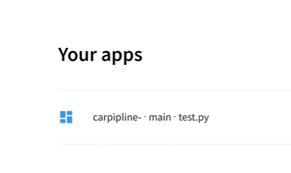
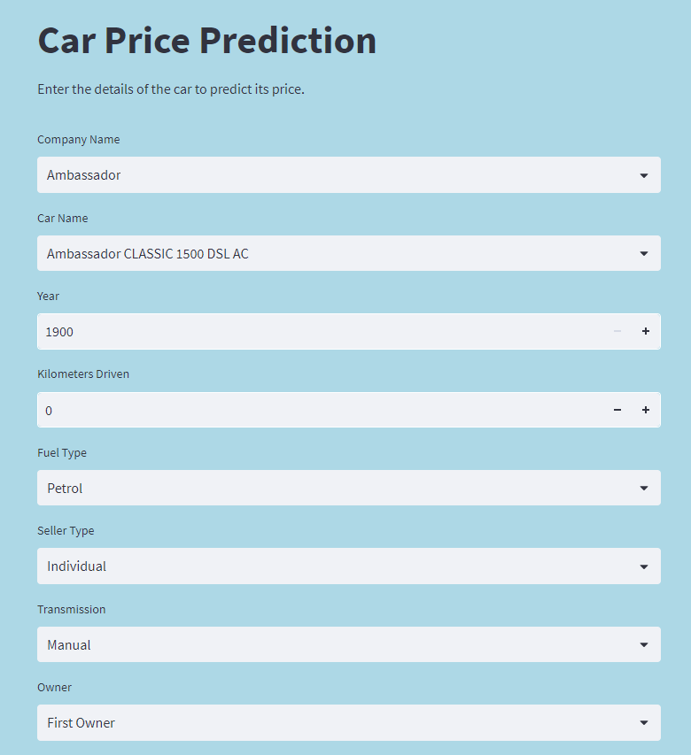
Deployment of ML Models using Streamlit.
Click Here

Slide 10
End notes
Github Link – Here
streamlit website Link - Here
By – Luhana Tulshaben

